Slide 1




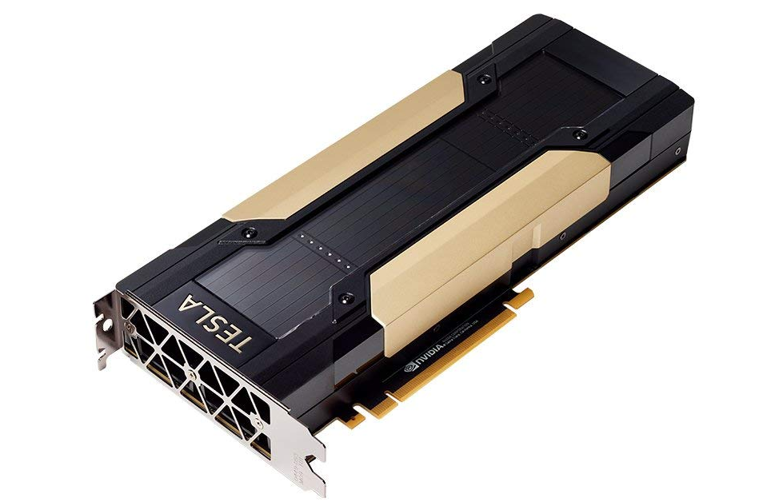
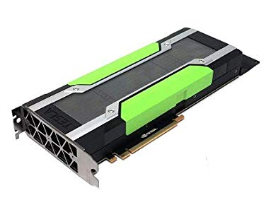
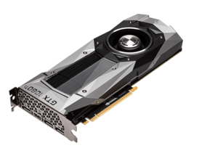
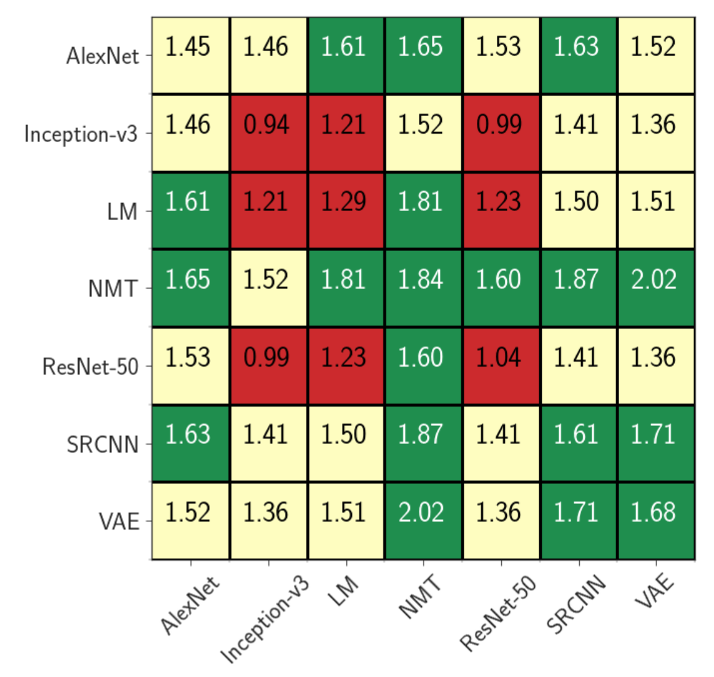
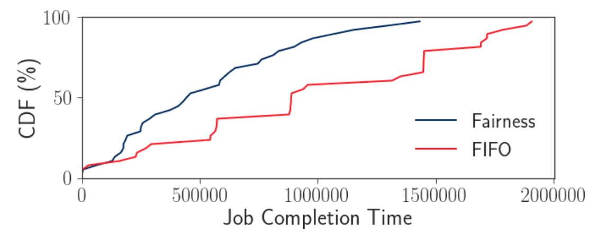
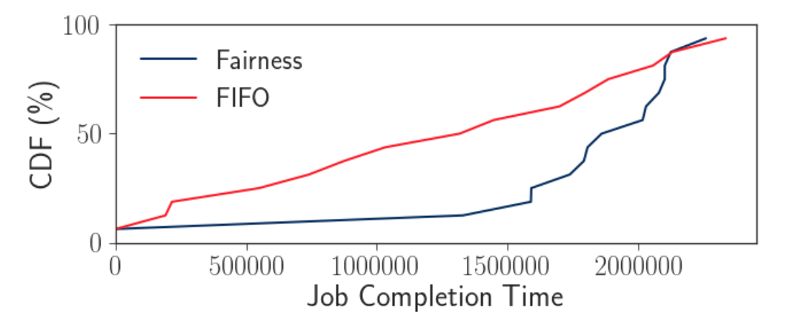
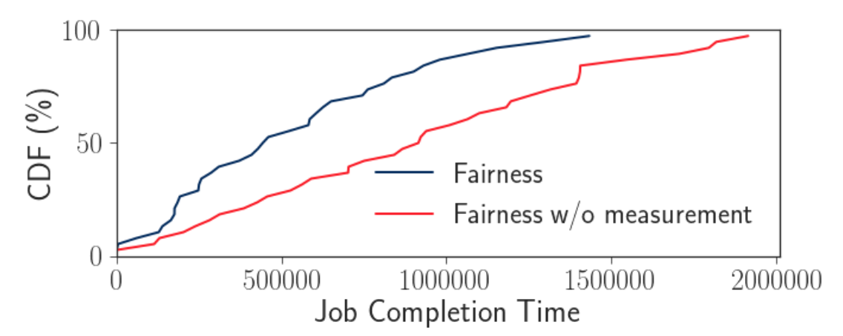
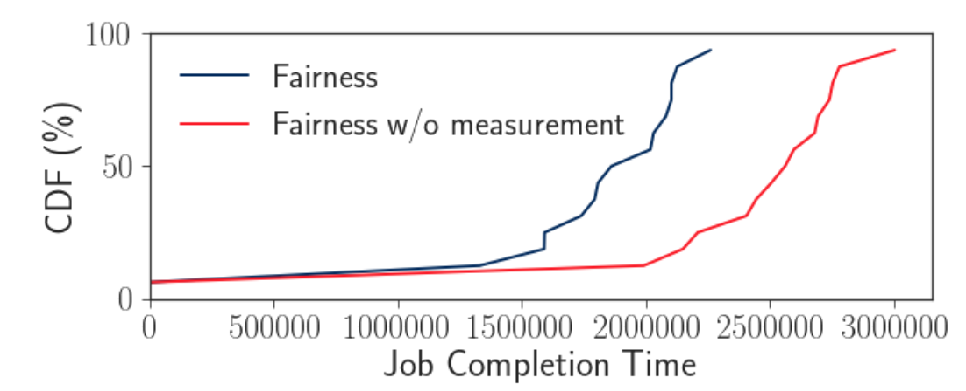
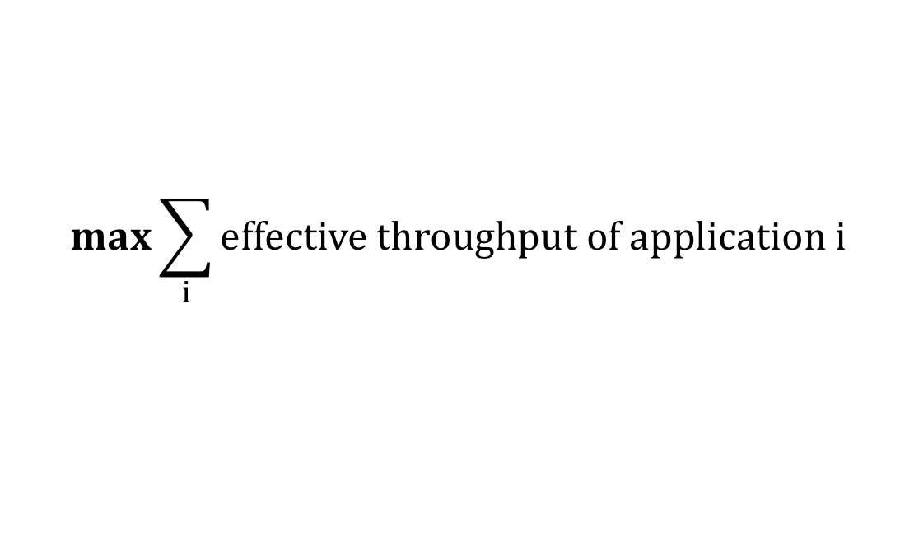
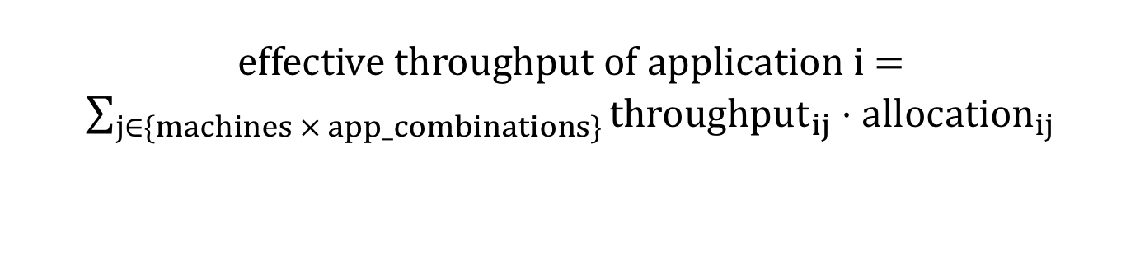
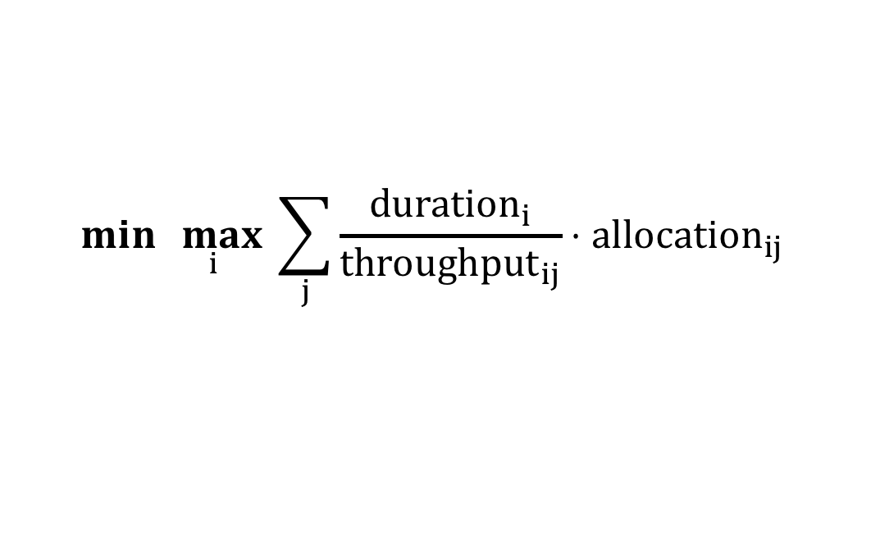
A Scheduler for Efficiently Sharing GPU Clusters for Deep Learning Workloads
Deepak Narayanan*, Keshav Santhanam*, Amar Phanishayee†, Matei Zaharia*
*Stanford University, †Microsoft Research
Motivation
GPUs for DL training are expensive!
Clusters of GPUs can help reduce cost
Challenges
Solution: Time- and Space- sharing of GPU resources
Challenge #1: High Queuing Delay
Challenge #2: Poor GPU Utilization once scheduled
Time-sharing: Helps to ameliorate queuing delays and give every user a fair share of the cluster
Space-sharing: Packs multiple applications onto the same GPU, helping to improve GPU utilization
Cluster has heterogeneous GPUs (e.g., V100s, P100s, Titan 1080 Tis)
Users request a fixed number of GPUs of a particular type
Applications in queues until resources are available, and then granted exclusive access
Queuing delay due to fragmentation often significant! [1]
Mean GPU utilization at ~52% on a Microsoft production cluster [2]
This work: How do we do this in a principled way according to a user-specified policy?
System Architecture
Applications written in existing frameworks
Profiler
Throughput
measurements
Policy
Allocation
The scheduler assigns applications to worker GPUs according to computed allocation
Cluster of heterogeneous GPUs
{
resnet50: {v100: 200,
p100: 100},
nmt: {v100: 50,
p100: 50},
resnet50 + nmt: {}
}
{
resnet50: {v100: 0.2,
p100: 0.6},
nmt: {v100: 0.5,
p100: 0.2},
resnet50 + nmt: {}
}
Supported Policies
Fairness: Maximizes the minimum throughput across users
Throughput: Maximizes total throughput
Weighted Fairness: Maximizes the minimum weighted throughput across users / applications
Job Completion Time: Minimizes the maximum job completion time
Policy 1: Fairness
Policy 3: Weighted Fairness
$$\max{\min_{i}{ effective throughput of application i}}$$
$$\max{\min_{i}{ effective throughput of application i⋅w_{i}}}$$
Policy 2: Throughput
Policy 4: Job Completion Time
$$\max{\sum_{i}{effective throughput of application i}}$$
$$\min{\max_{i}{ \sum_{j}{\frac{duration_{i}}{throughput_{ij}}⋅allocation_{ij}}}}$$
effective throughput of application i = $\sum_{j∈\{machines × app_combinations\}}{{throughput}_{ij}}⋅allocation_{ij}$
Evaluation
Space-sharing can help increase GPU throughput
Fairness policy reduces average JCT by 15% compared to a FIFO scheduler
(a) Short Jobs
(b) Long Jobs
Throughput measurements help compute better performing fair policies, reducing average JCT by 34%
Throughput increase from colocation shows wide variance from 1x to 2x
Certain types of application combinations can achieve a throughput increase of as much as 80%
(a) Short Jobs
(b) Long Jobs
Synthetic trace generated using a job duration CDF from Gandiva [2] and a Poisson Arrival process
[1] Multi-tenant GPU Clusters for Deep Learning Workloads: Analysis and Implications, Jeon et al.
[2] Gandiva: Introspective Cluster Scheduling for Deep Learning, Xiao et al., OSDI 2018

